Slide 1
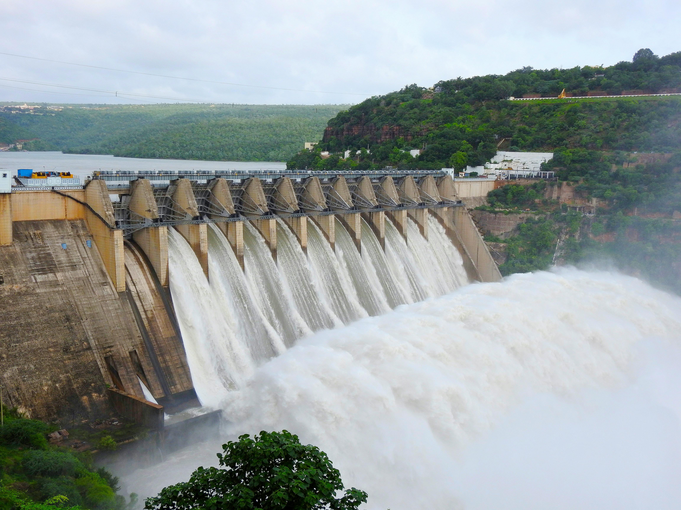
AUTOMATIC DAM SHUTTER SYSTEM

Slide 2
TABLE OF CONTENTS
ESP 32 Microcontrollers
Sensors
Ultrasonic sensor
Float switch sensor
Indicators
Led
Buzzer
Cloud storage

Slide 3
AUTOMATIC DAM SHUTTER SYSTEM
An automatic dam shutter system is designed to control the flow of water in and out of a dam or reservoir. This system typically involves sensors, actuators, and a control mechanism that work together to adjust the position of shutters or gates based on real-time water levels, rainfall, and other environmental factors.
Functionality:
Monitoring: Sensors continuously track water levels and environmental conditions.
Decision Making: The control system analyzes the data to determine when to open or close the shutters.
Actuation: Actuators adjust the position of the shutters accordingly.
Safety Protocols: Built-in fail-safes to prevent malfunctions or accidents during extreme weather or system failures.

Slide 4

ESP 32 Microcontroller
The ESP32 is a popular microcontroller known for its versatility and robust features, making it a
favorite for IoT (Internet of Things) projects.
Key Features
Dual-Core Processor:
The ESP32 is equipped with a dual-core Tensilica LX6 processor, allowing for efficient
multitasking.
Wireless Connectivity:
Wi-Fi: 802.11 b/g/n support for robust internet connectivity.
Bluetooth: Supports Bluetooth Classic and BLE (Bluetooth Low Energy) for short-range
communication.
Low Power Consumption:
Features several power modes, including deep sleep, making it suitable for battery-powered
applications.

Slide 5
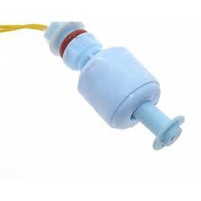
Float Switch Sensor
A float switch is a type of level sensor, a device used to detect the level of liquid within a tank. The switch may be used to control a pump, as an indicator, an alarm, or to control other devices.

Slide 6
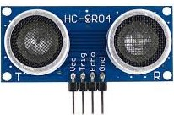
Ultrasonic Sensor
An electronic instrument that uses ultrasonic sound waves (through air) to measure the distance of the target object and the reflected sound is converted into electrical signal.

Slide 7
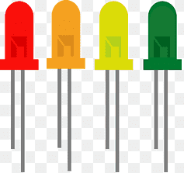
LED Indicators
LED indicators are simple yet effective devices used to convey information visually through light. They are commonly found in various electronic devices and systems, providing status updates or alerts.

Slide 8
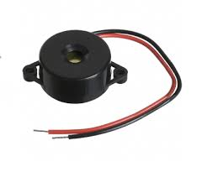
Buzzer
A buzzer is an audio signaling device that makes a buzzing or beeping sound when an external voltage is applied. Buzzers can be mechanical, electromechanical, or piezoelectric. They are commonly used in alarm devices, timers, computers, printers, and other electronic products.

Slide 9
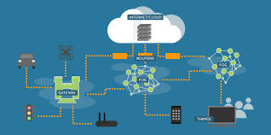
Cloud Storage
Cloud computing is the delivery of computing services over the internet, or "the cloud". It allows companies to access computing resources on-demand, without the need to buy and maintain physical infrastructure.
The cloud is used in IoT projects using sensors for a variety of reasons, including:
Data storage: The cloud stores the large amounts of data collected from sensors.
Data analysis: The cloud can analyze, interpret, and manipulate the data collected
from sensors.
Data processing: The cloud can process the data collected from sensors.
Data sorting: The cloud can sort the data collected from sensors.
Data computing: The cloud can compute the data collected from sensors.
Data use: The cloud can use the data collected from sensors in other ways.

Slide 10
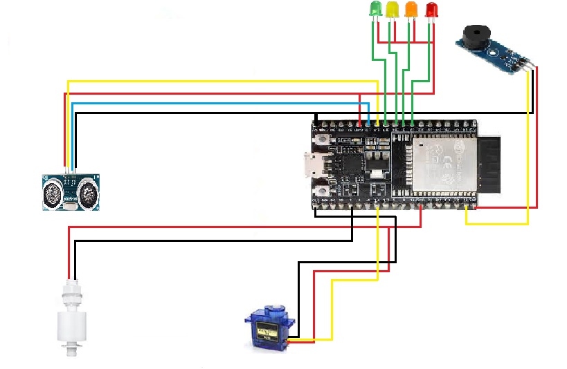
Circuit Diagram

Slide 11
Benefits:
Efficiency: Reduces the need for manual intervention, saving time and labor.
Safety: Minimizes the risk of human error in critical situations.
Predictive Management: Allows for proactive management of water resources based on real-time data.
Applications:
Hydroelectric Power Plants: Managing water flow for electricity generation.
Flood Mitigation: Protecting downstream areas from flooding.

